Slide 1
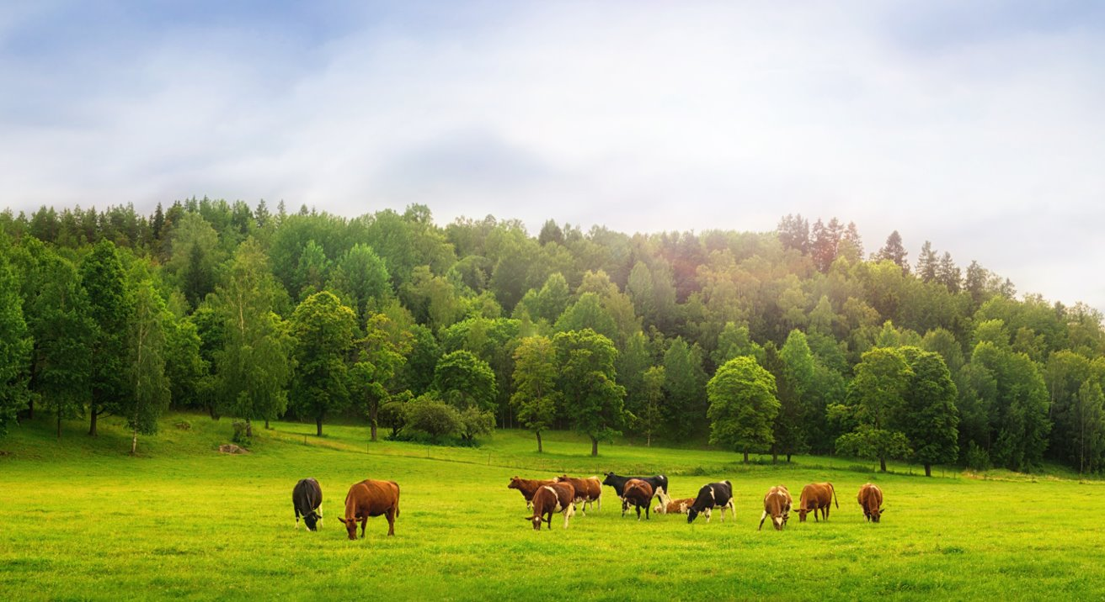

PRESENTED BY
Presenter Name
Presenter Title
Presenter Company
The Organic Opportunity
GOOD FOR THE PLANET
GOOD FOR PEOPLE
GOOD FOR BUSINESS

Slide 2
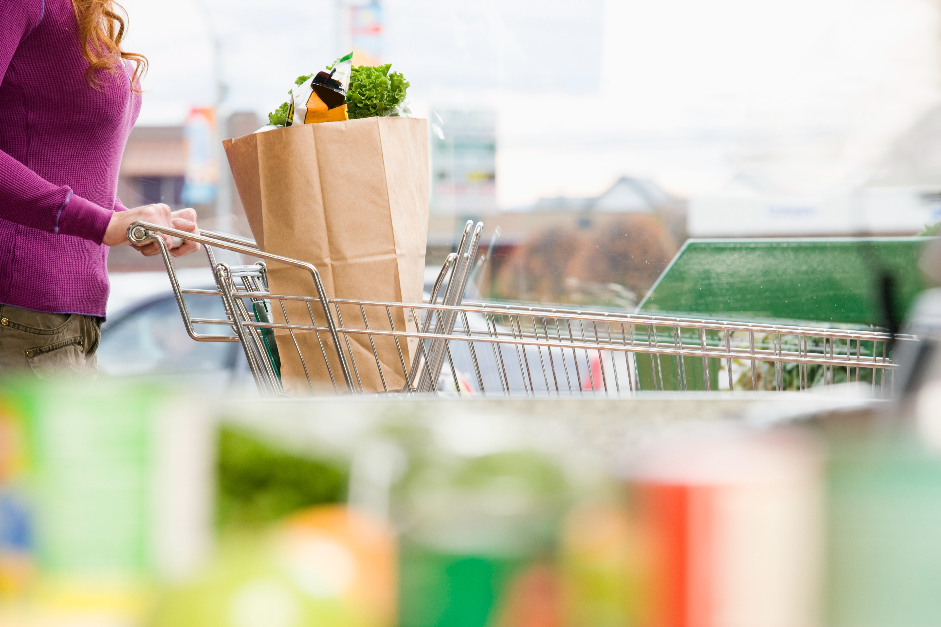
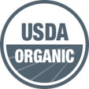


Whichever sustainability benefits are most important to your business, from reducing greenhouse gases to protecting human health, there’s only one option that addresses the full suite of environmental and social concerns and is backed by federal certification—USDA Organic.
When surveyed about their top concerns
in the food and beverage industry,
most consumer priorities were addressed
by the organic standard. For example,
70% expressed concerns over the use
of synthetic chemicals and GMOs,
which are prohibited in organic products.
ORGANIC CONTINUES TO BE
ONE OF THE FASTEST GROWING
SECTORS IN US AGRICULTURE:
IN 2020, ORGANIC SALES
GREW BY 12.4% TO A
RECORD HIGH OF $62 BILLION.
More than 82%
of US households
stock organic food
in their kitchens.
Notes:
References:
Over 82% of US households stock organic food (Nielsen, 2016).
When surveyed about their top concerns in the food and beverage industry, most consumer priorities were addressed by the organic standard. For example, 70% expressed concerns over the use of synthetic chemicals and GMOs, which are prohibited in organic products. (Edelman, 2022).
IN 2020, ORGANIC SALES GREW BY 12.4% TO A RECORD HIGH OF $62 BILLION (Organic Trade Association, Organic Industry Survey, 2021).

Slide 3
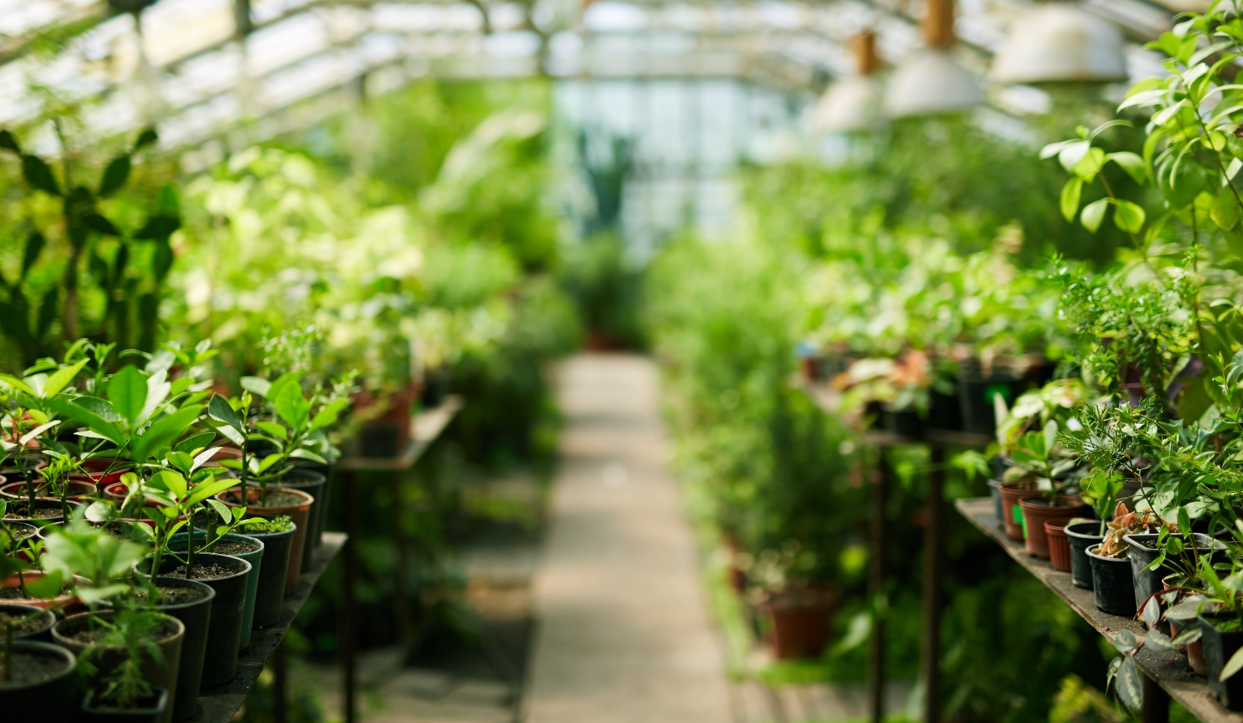
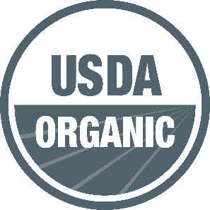








The Organic Guarantee
Unique among all eco-labels, USDA organic is backed
by third party inspection, federally enforced, and
provides traceability from the farm to the consumer​.
ORGANIC PRODUCERS
ARE REQUIRED TO . . .
ORGANIC PROHIBITS . . .
THE USDA ORGANIC SEAL
ENSURES THAT . . .
Protect natural resources
and support biodiversity​.
Synthetic nitrogen fertilizers, soil fumigants, and sewage sludge.
Organic is a federally defined term with a clear meaning that strictly regulates how agricultural products are grown, raised and processed.
Every processor and part of the organic processing chain is certified and traced from farm to finished product.
Fraud is a serious crime and cheating in organic can result in loss of certification and severe financial penalties.
Build soil health through
regenerative practices like cover cropping and crop rotation.
Genetically Modified
Organisms (GMOs).
Support the health and accommodate the natural behavior of all their animals, year-round.
Toxic pesticides and chemicals.
Notes:
References:
•(USDA Organic Regulations 7 CFR Part 205)

Slide 4






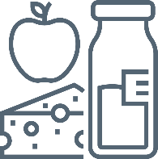
What is Organic Certification?
Develop
Organic
System Plan
Submit Plan
to Certifier
Certifier
Review
CERTIFICATION DECISION
Inspection
From the land on which an organic product is grown, to the producers growing the product,
from the post-harvest facilities preparing the product, to the processing and handling facilities transforming the product, each step must be certified to the federal organic standards.
Once an operation is certified, they must go through annual reviews and on-site inspections
as well as surprise inspections.

Slide 5
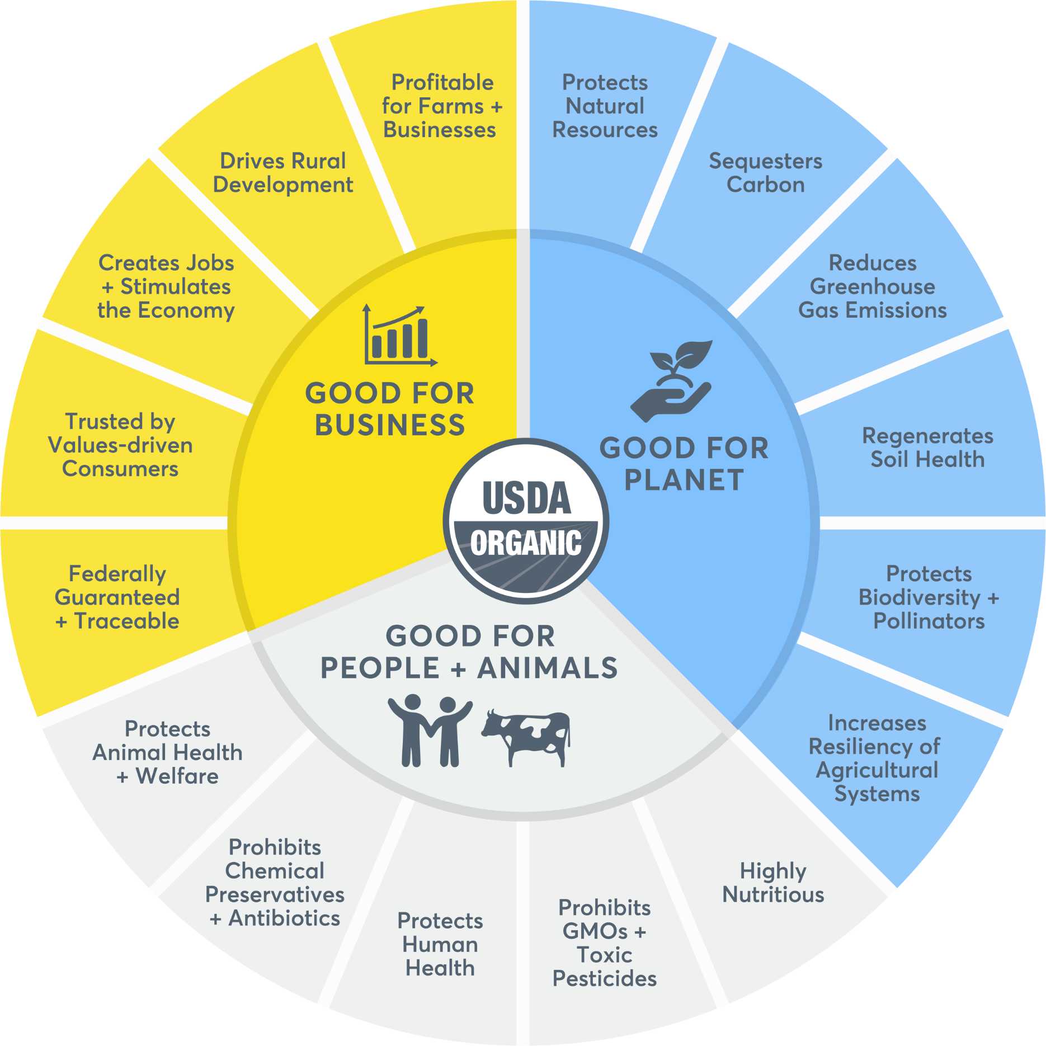
The Organic Wheel
of Sustainability
GOOD FOR THE PLANET,
GOOD FOR PEOPLE,
GOOD FOR BUSINESS.

Slide 6
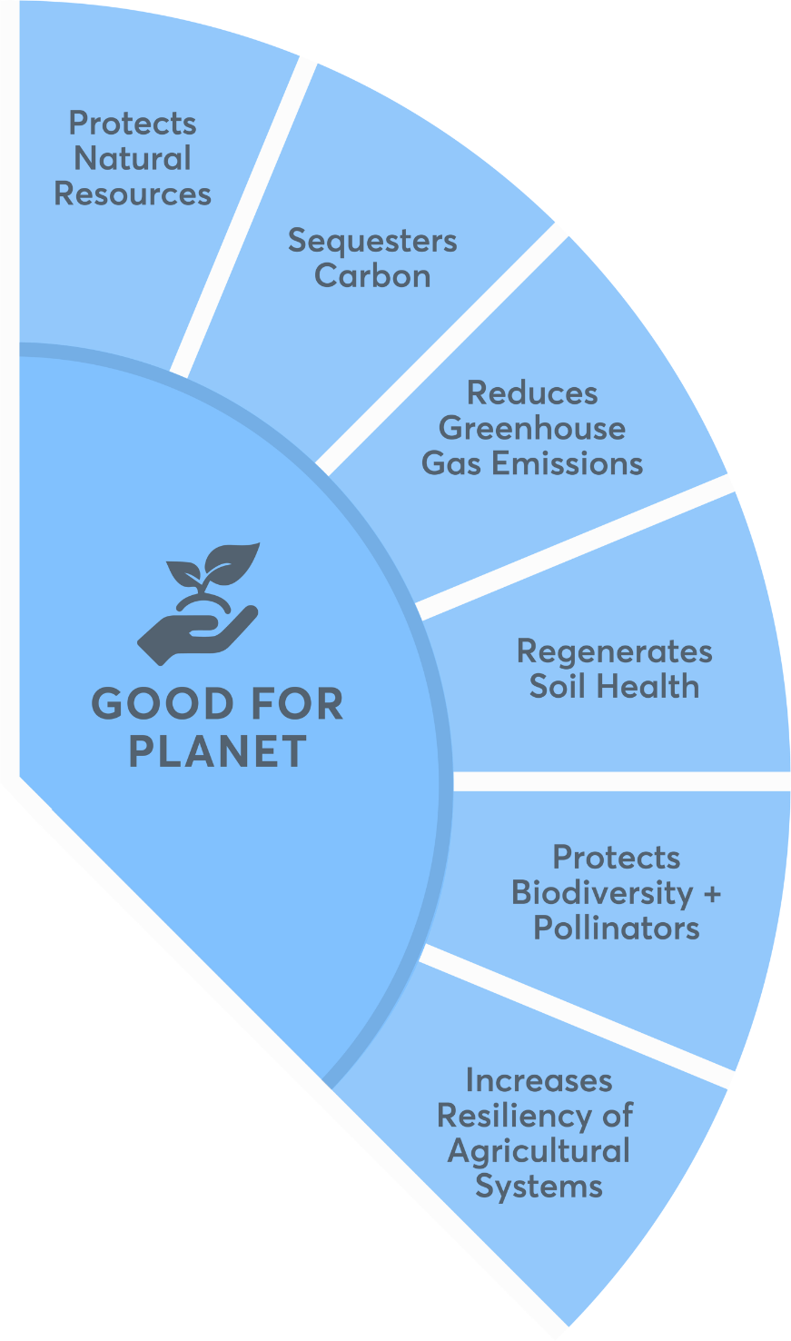
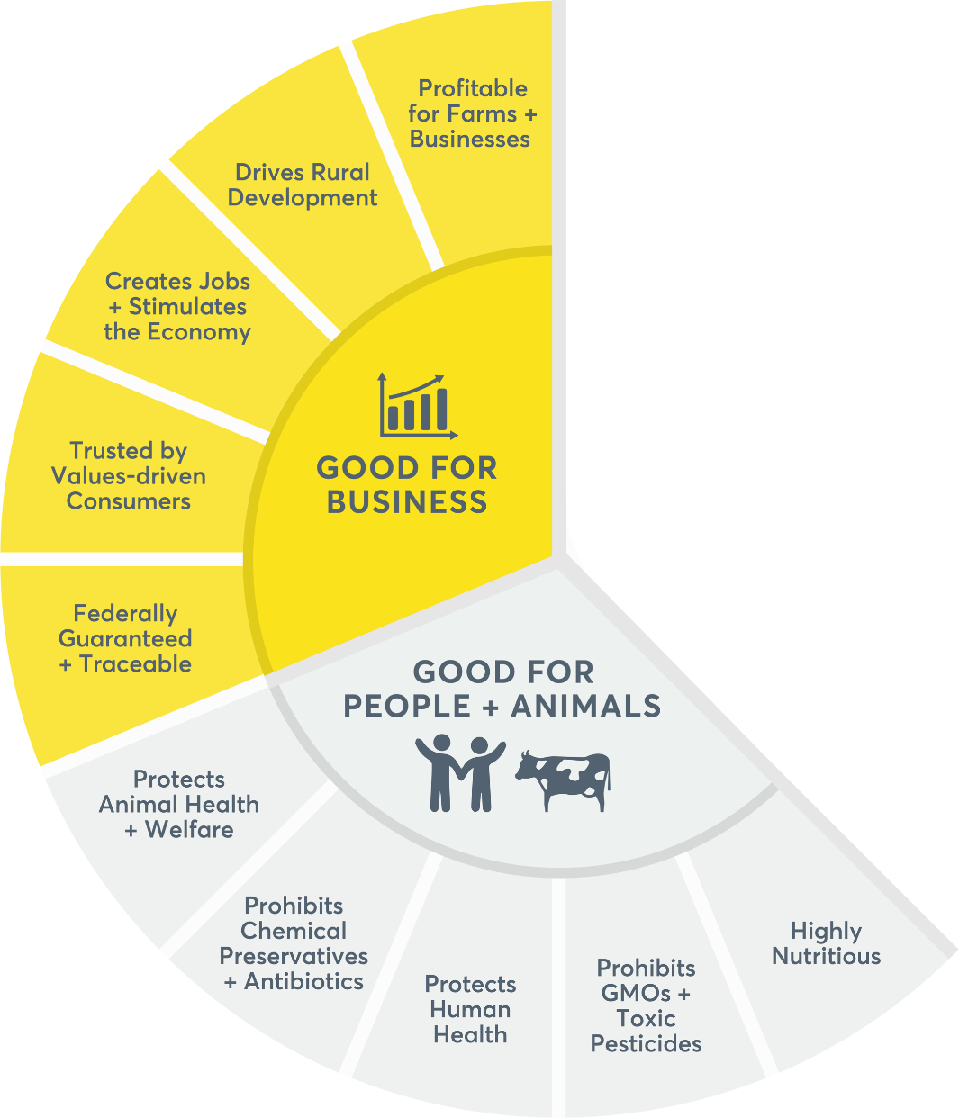
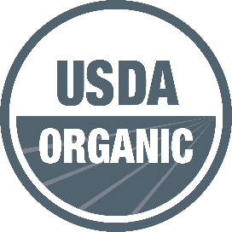

GOOD FOR THE PLANET
By relying on ecosystem services to produce food
and fiber, organic farms have a regenerative—rather than extractive—effect on the environment. Organic standards require that farmers protect the natural resources on their lands, which makes organic farms key players in the fight against the climate crisis.
ORGANIC WHEEL
OF SUSTAINABILITY

Slide 7

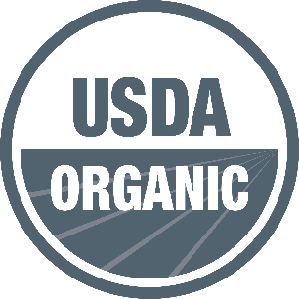
Organic is Regenerative and So Much More!
Organic is a regenerative, whole system approach to farming and food production that ensures certified products are always grown, processed, and handled according to rigorous environmental, health, and animal welfare standards. USDA Organic is the only environmental label claim in the United States that legally requires 3rd party certification from farm to finished product and is backed by federal oversight and enforcement.
REGENERATIVE
(NON-ORGANIC)
ORGANIC
No. The term “regenerative agriculture” has been used for some time, but there is no standardized definition to date.
Federally Defined
+ Guaranteed
Yes. The USDA Organic label is backed by third party certification and federal oversight, which provides traceability from farm to consumer. Cheating in organic can mean losing certification and significant financial penalties.
Notes:
References:
•(USDA Organic Regulations 7 CFR Part 205)

Slide 8





Protects Natural Resources and Biodiversity
Organic farmers are required to maintain or improve the natural resources on and around their farms, including soil, water, wetlands, and wildlife habitats. By avoiding toxic chemicals and maintaining healthy wildlife habitats, organic practices promote biodiversity and protect pollinators.
Protects Natural Resources
Required. Organic farmers are required to build soil health, support biodiversity, protect water quality, and reduce soil erosion through activities
such as crop rotation, cover cropping
and composting.
ORGANIC FARMS . . .
Chemical Fertilization
Prohibited. Synthetic nitrogen fertilizers, soil fumigants and sewage sludge (“biosolids” are strictly prohibited).
Increase
overall
biodiversity
by 30% and
pollinator
diversity by
up to 50%.
Reduce
nitrates
released into groundwater
by 50%.
Synthetic Pesticides
Prohibited. Pest management on
organic farms relies first upon prevention, monitoring, and natural/biological controls. As a last resort, producers may select from a limited toolbox of non-toxic pest control options approved by the National Organic Standards Board and USDA.
Notes:
References:
(USDA Organic Regulations 7 CFR Part 205)
Increase overall biodiversity by 30% and pollinator diversity by up to 50%. (Journal of Applied Ecology, “Land-use intensity and the effects of organic farming on biodiversity: a hierarchical meta-analysis,” 2013).
Reduce nitrates released into groundwater by 50% (British Ecological Society, “Land-use intensity and the effects of organic farming on biodiversity: a hierarchical meta-analysis,” 2013).

Slide 9
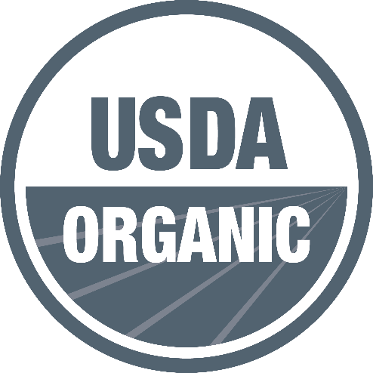


Sequesters Carbon and Reduces GHG Emissions
ORGANIC FARMS . . .
Emit 18% less global warming-causing gases
and use ~50% less new reactive nitrogen
(an extremely potent greenhouse gas).*
Produce healthier soils that contain
13% higher total organic matter and capture
44% more stable sequestered carbon.*
Releases 40% fewer carbon emissions.*
*As compared to conventional
Notes:
References:
Emit 18% less global warming causing gases and use ~50% less new reactive nitrogen (an extremely potent greenhouse gas) (Laura Cattell Noll et al 2020 Environ. Res. Lett. 15 045004).
Produce healthier soils that contain 13% higher total organic matter and capture 44% more stable sequestered carbon (Science Direct, 2017. “Advances in Agronomy”. Volume 146, Pages 1-35).
Release 40% fewer carbon emissions. (Rodale Institute, “Farming Systems Trial 1981 – Present").

Slide 10
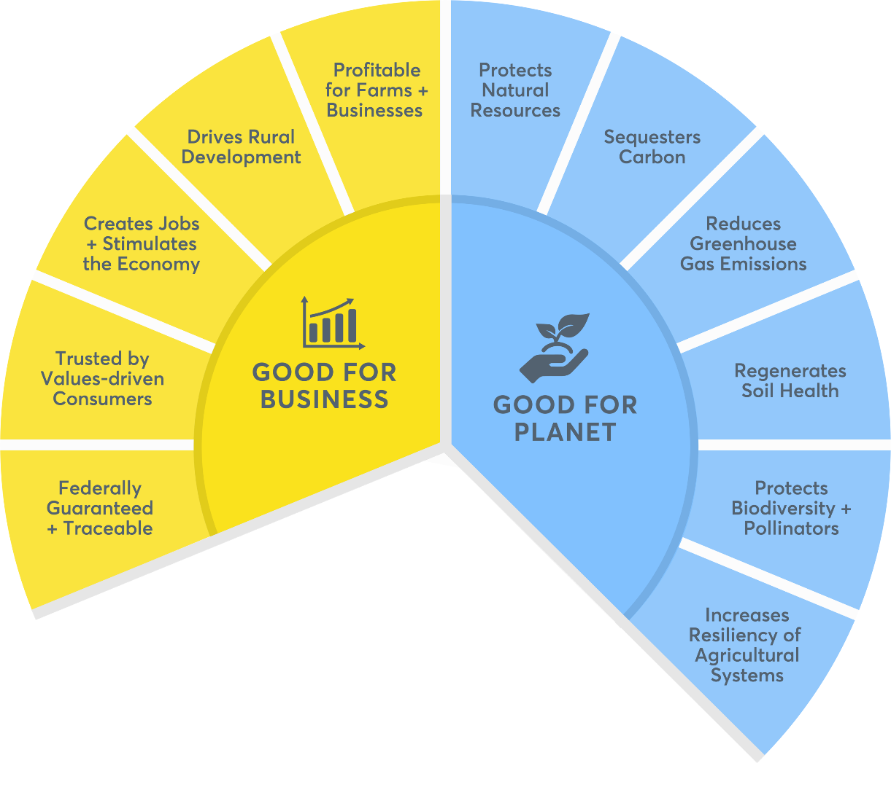
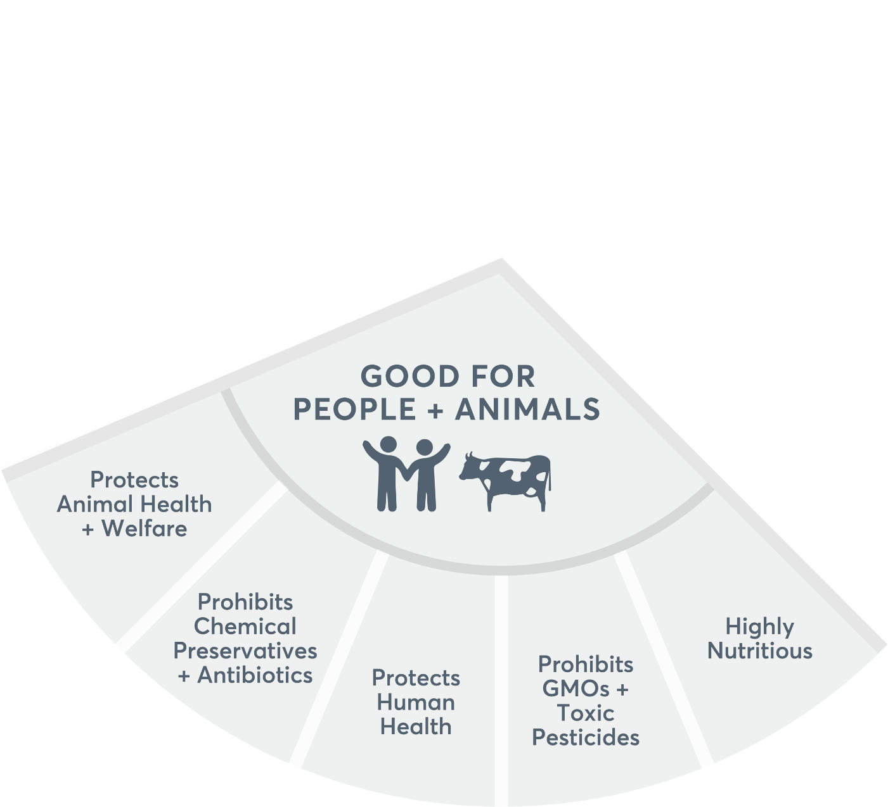

GOOD FOR PEOPLE AND ANIMALS
Organic is the only label claim federally certified
to always be non-GMO and produced without
the toxic pesticides, chemical preservatives,
or antibiotics that can be harmful to consumers, farmworkers, and animals.
ORGANIC WHEEL
OF SUSTAINABILITY

Slide 11
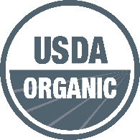

Nutritious and Delicious
Organic food not
only tastes delicious, it's also rich in the vitamins and nutrients that health-conscious consumers—especially those with families—
are increasingly seeking out.
ORGANIC, A HEALTHIER OPTION
PRODUCE
BEEF
MILK
Richer in iron, vitamin E, and carotenoids.
UP TO
69%
56%
UP TO
32%
UP TO
17%
24%
HIGHER Antioxidants
LESS
Cholesterol
LESS
Fat
FEWER Monounsaturated Fatty Acids
HIGHER
Healthy Omega-3 Fatty Acid Levels
Nutritional data as compared to conventional products
Notes:
Chart: nutrition
Produce: Higher anti-oxidants (British Journal of Nutrition, “Higher antioxidant and lower cadmium concentrations and lower incidence of pesticide residues in organically grown crops: a systematic literature review and meta-analyses,” 2014).
Beef: Less cholesterol, fat, and monosaturated fatty acids (Journal of the Science of Food and Agriculture, “Nutritional properties of organic and conventional beef meat at retail,” 2019).
Milk: Higher Omega 3 fatty acids (British Journal of Nutrition, “Higher PUFA and n-3 PUFA, conjugated linoleic acid, α-tocopherol and iron, but lower iodine and selenium concentrations in organic milk: a systematic literature review and meta- and redundancy analyses,” 2016).

Slide 12
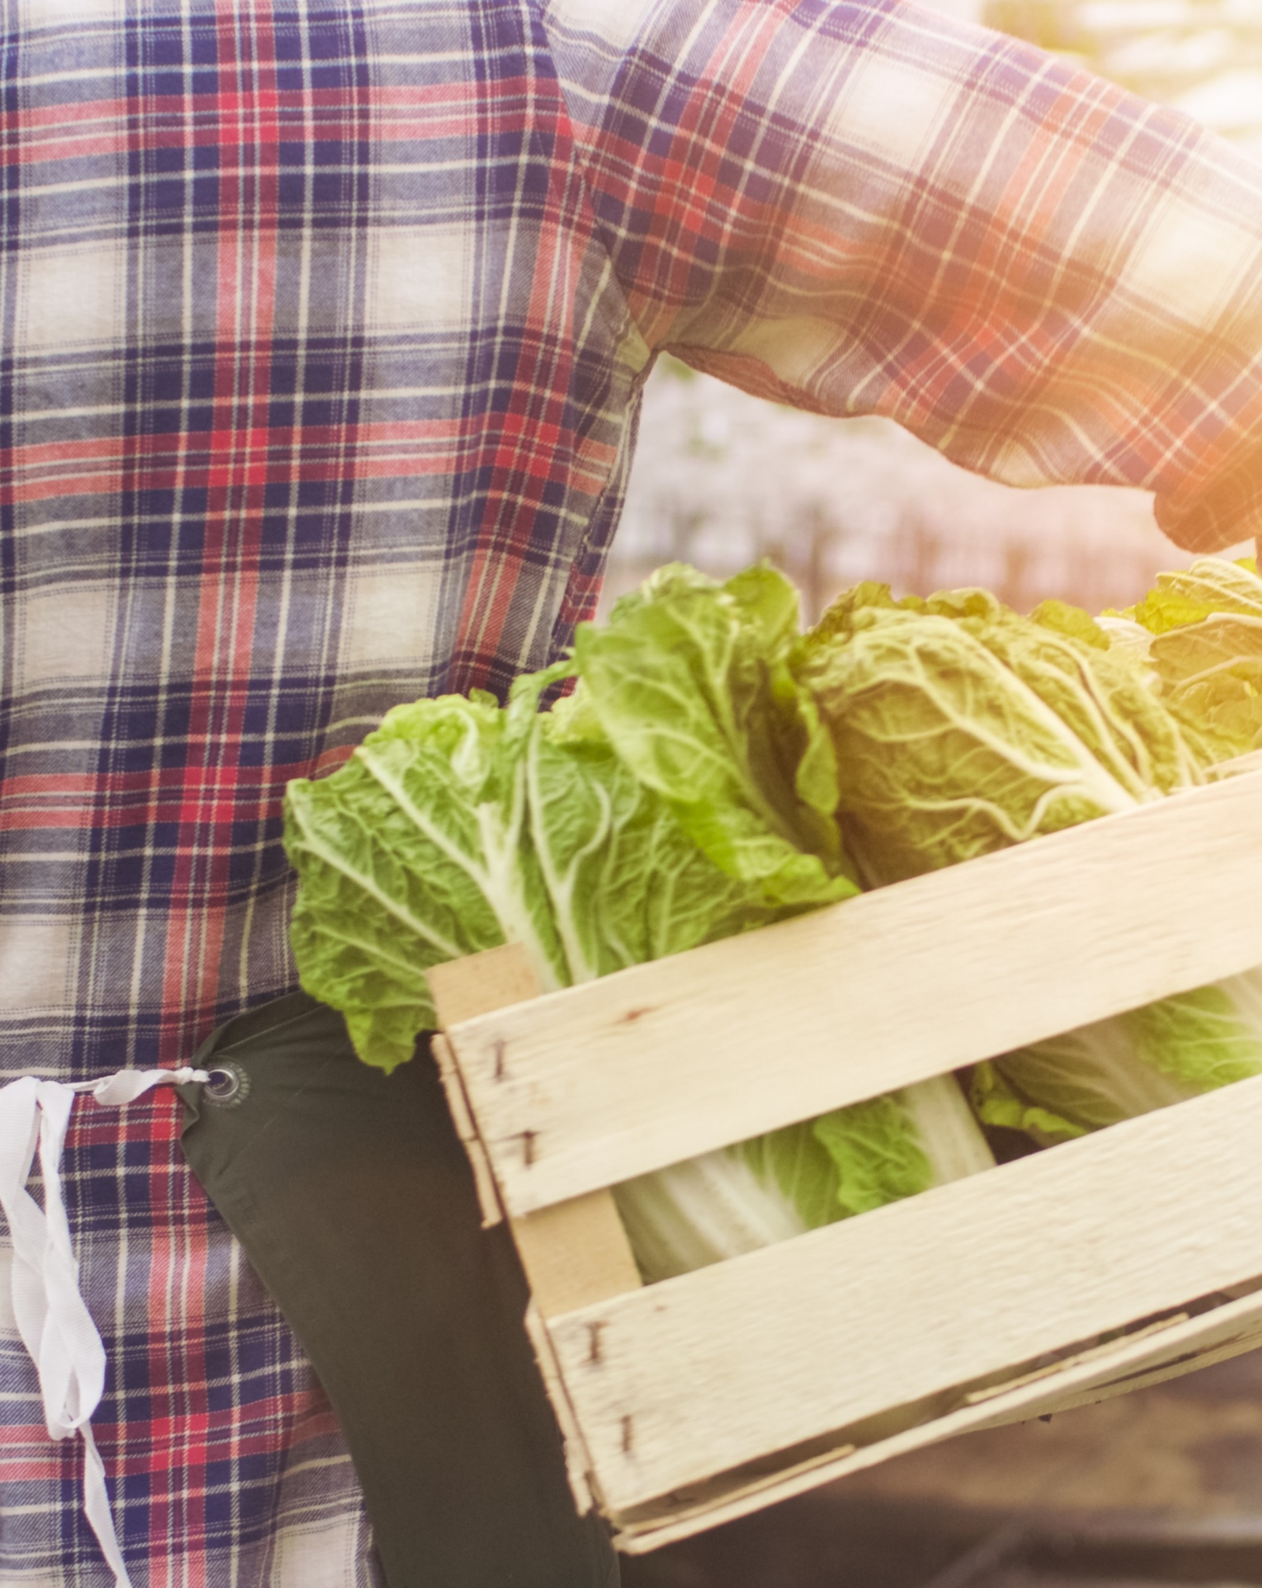


Protecting Families,
Protecting Farmworkers
Organic agriculture drastically reduces environmental and dietary exposure to toxic pesticides, protecting families and farmworkers alike
Pesticide residues in organic produce
are 55x lower in vegetables and 115x lower
in fruits versus conventional produce.
Organic protects frontline farmworkers,
who experience the most danger of acute exposure and health consequences.
Notes:
References:
Pesticide residues in organic produce are 55× lower in vegetables and 115× lower in fruits versus conventional produce. (Agronomy, “Organic Farming Lessens Reliance on Pesticides and Promotes Public Health by Lowering Dietary Risks,” 2021.) (TOC Summary)
Organic protects frontline farmworkers, who experience the most danger of acute exposure and health consequences (The Organic Center, “Critical Issue Report: Occupational Pesticide Exposure,” 2018.)

Slide 13
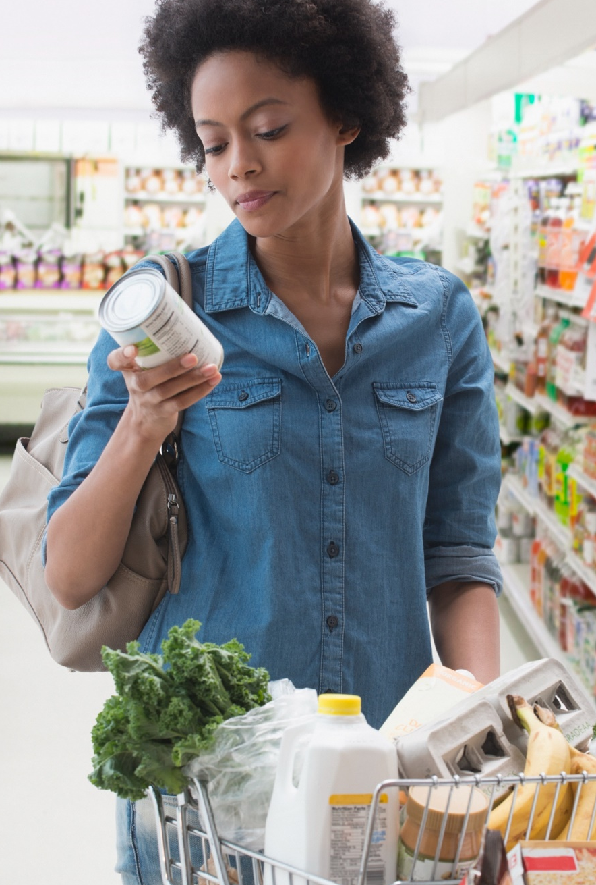

A Healthy and Safe Choice
NATURAL, ORGANIC INGREDIENTS
NON-GMO
Organic foods are processed in
a way that maintains the integrity of
the product that began with practices
on the farm. Organic food processors follow strict legal restrictions on allowable materials and take extra steps to make sure organic ingredients are not contaminated with non-organic materials. Organic always means:
NO artificial flavors
NO artificial colors
NO artificial preservatives
All organic products are non-GMO,
and a whole lot more! Genetically modified organisms (GMOs) are prohibited in organic products. This means an organic farmer can’t plant GMO seeds, an organic cow can’t eat GMO alfalfa or corn, and an organic manufacturer can’t use any GMO ingredients. Organic farmers and processors must show they aren’t using GMOs, and that they are protecting their products from contact with prohibited substances from farm to table.
Notes:
References:
(USDA Organic Regulations 7 CFR Part 205)

Slide 14
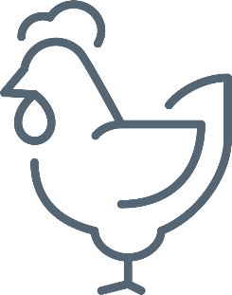



Protecting Animal Health and Welfare
Organic farmers and ranchers must support the health and accommodate the natural behavior of their animals year-round.
Animals must have access to pasture and the outdoors.
Animals must be raised on certified organic land,
fed 100% certified organic feed, and managed without antibiotics, growth hormones or slaughter byproducts.
The result? Healthy, happy animals that exhibit the behaviors nature intended and consumers expect.
WHAT ABOUT ANIMAL HEALTH AND WELFARE?
Organic farmers are required to raise animals without the use of antibiotics or synthetic growth hormones. Animals must have 100% organic feed and safe, comfortable living conditions that accommodate health and natural behaviors.
Organic farmers must provide their animals with access to the outdoors and pasture so that they can freely roam about. In fact, organic standards require that cows graze on grass for a minimum
of one third of their lives.
Notes:
References:
(USDA Organic Regulations 7 CFR Part 205)

Slide 15
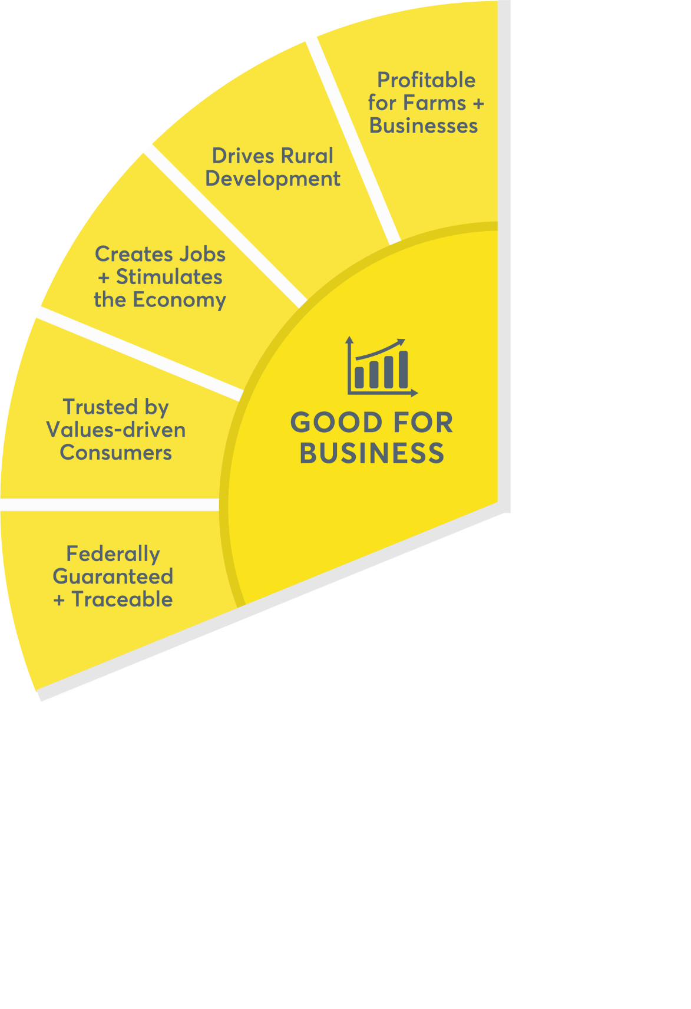
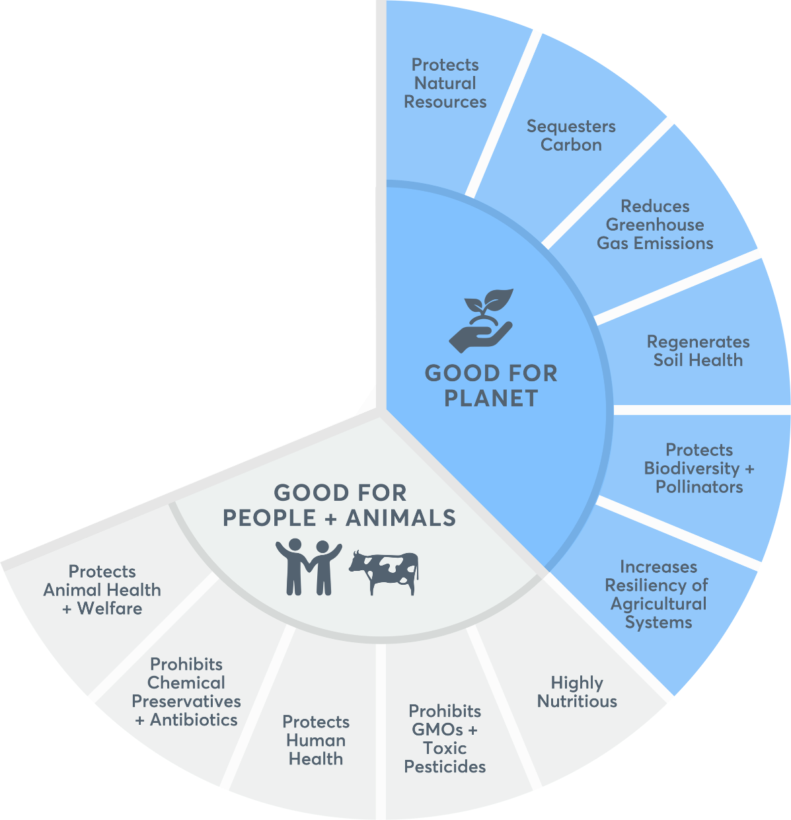

GOOD FOR BUSINESS
Customers want to know that brands and retailers have carefully considered their values and integrated purpose and societal impact into
the products they sell. Most surveyed consumers reported that organic was the label that best embodies their values.
ORGANIC WHEEL
OF SUSTAINABILITY

Slide 16
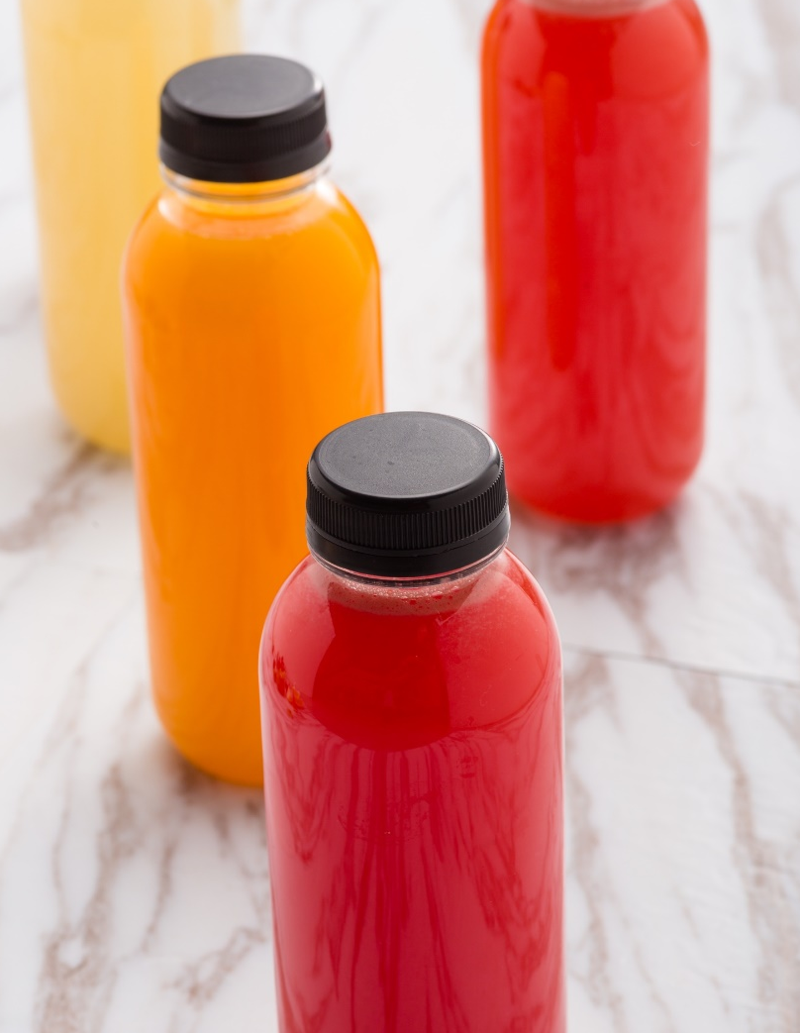
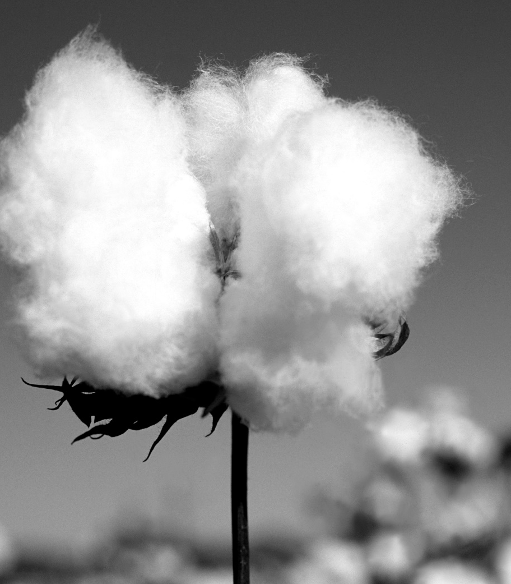

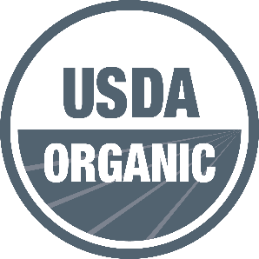

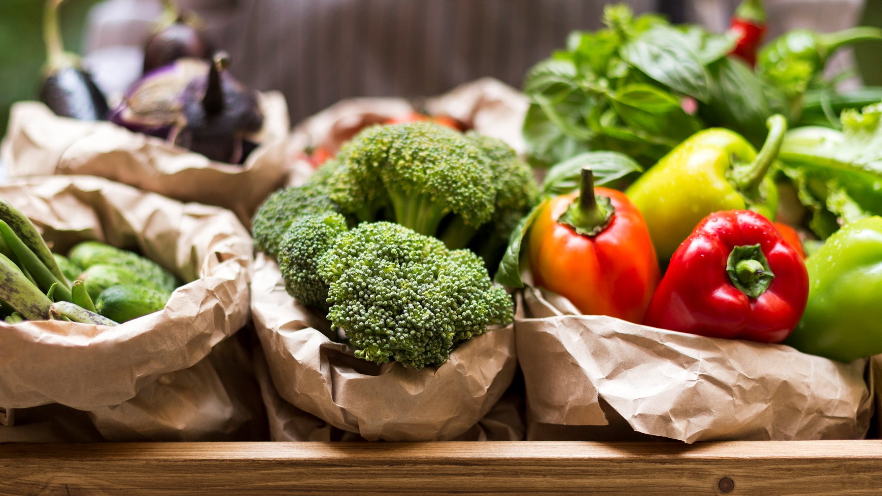
U.S. Organic Sales Reached a Record High of Over $63 Billion
in 2021
$56,485
BILLION
$5,438
BILLION
28,454
Nearly
13% growth
from
2020–2021
16,585
certified organic farms
with 5.5 million acres
in organic production
in 2019
Nearly
9% growth
from
2020–2021
FOOD
NON-FOOD
CERTIFIED OPERATIONS
Notes:
References: Organic Trade Association, Organic Industry Survey, 2021

Slide 17
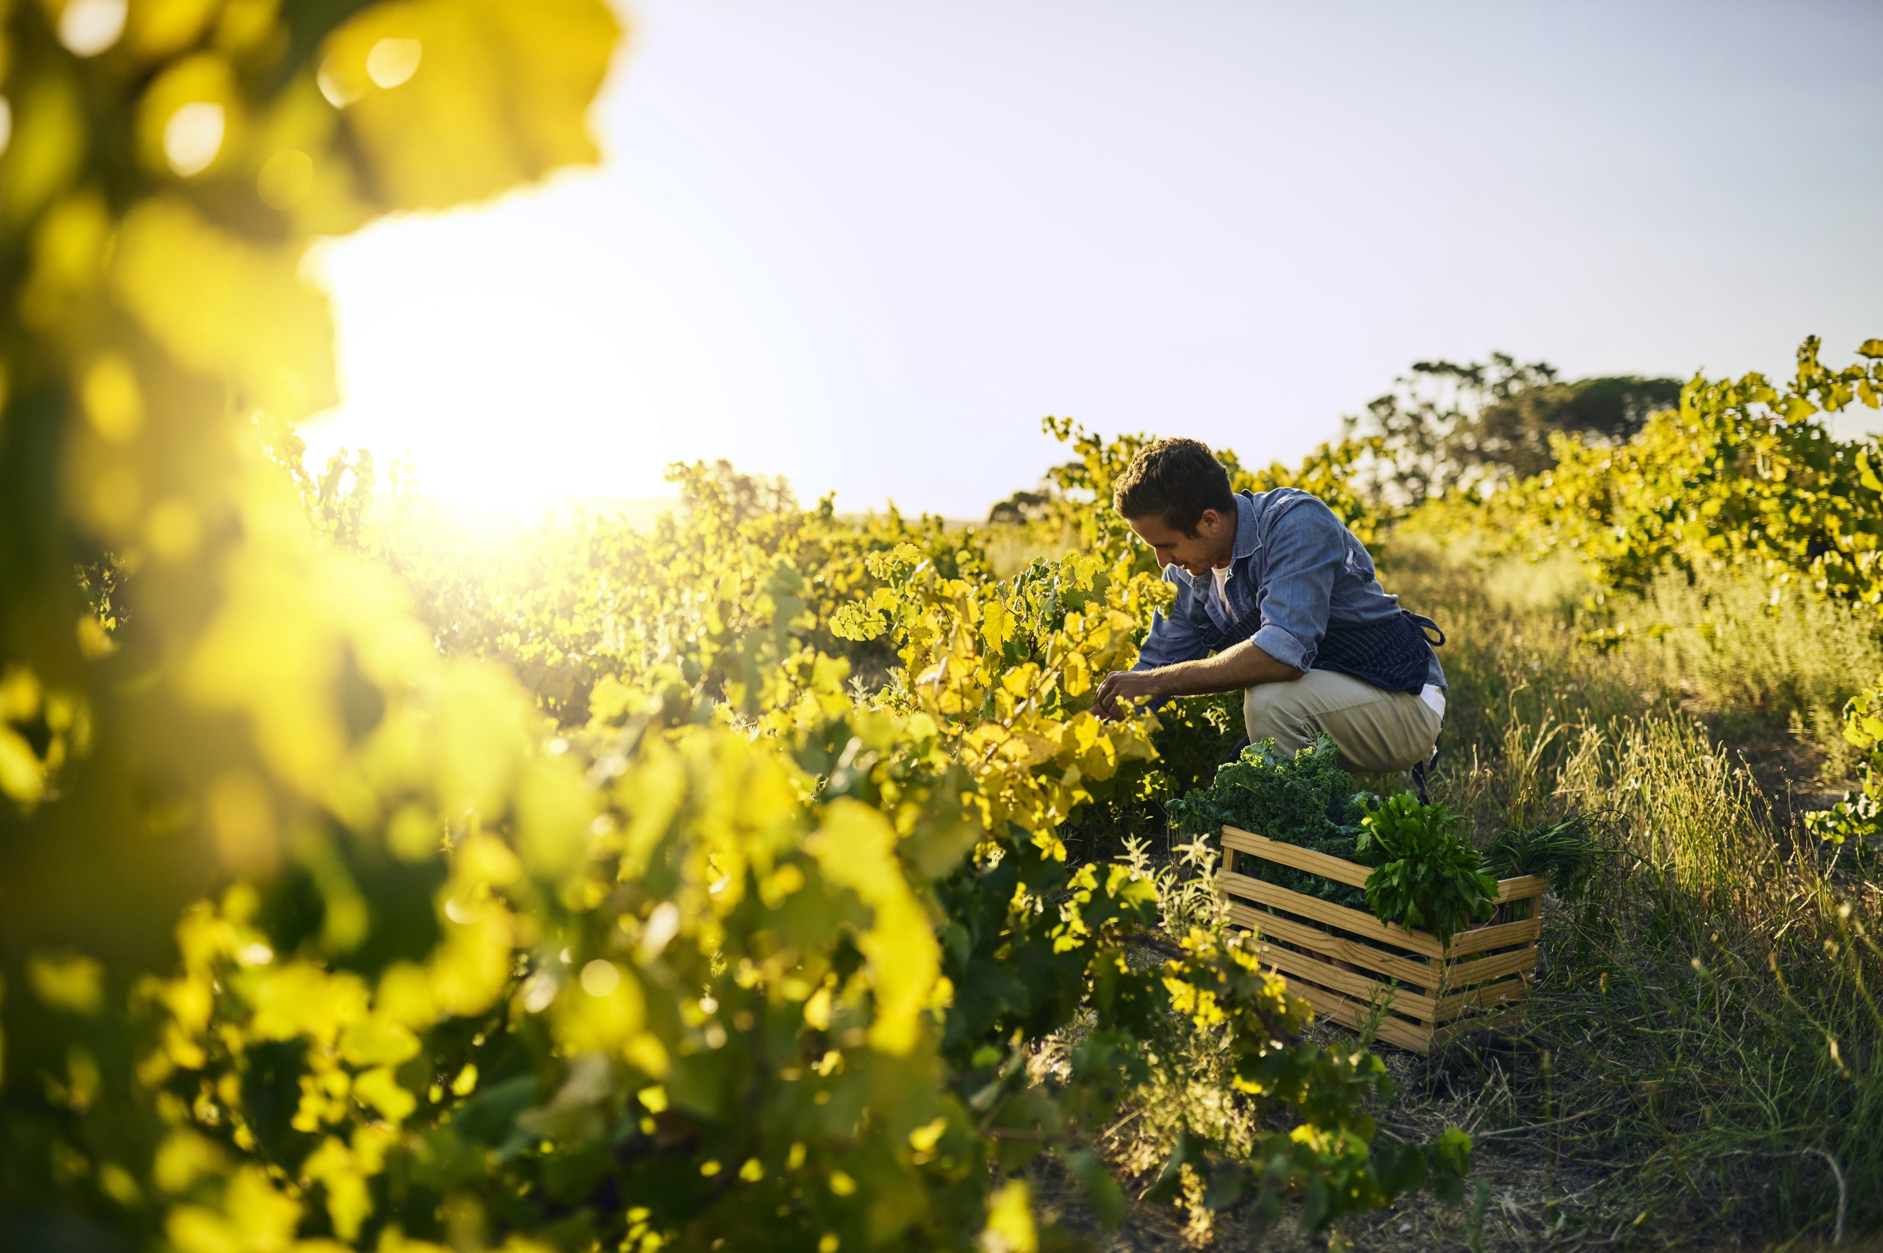


Creates Jobs,
Drives Development,
and Stimulates the Economy
Clusters of
organic businesses
LOWER THE
LOCAL POVERTY RATE BY
1.35%
Organic hotspots
INCREASE
HOUSEHOLD
INCOME
over $2,000
Notes:
References:
Clusters of organic businesses are correlated with reduced poverty, increased median household income, and higher participation in the labor force. (OTA White Paper, “U.S. Organic Hotspots and Their Benefit to Local Economies,” 2016).

Slide 18

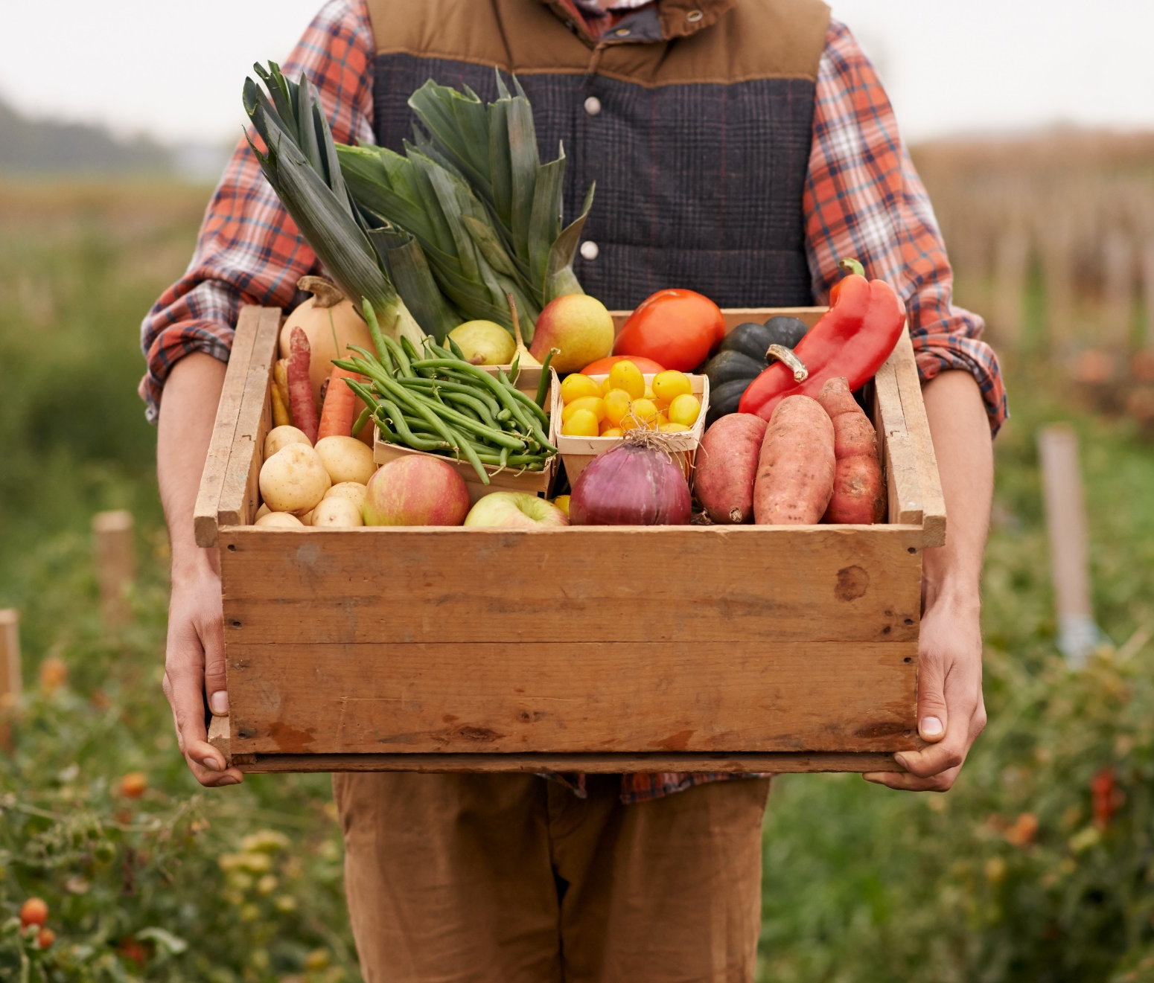

Profitable for Farms and Businesses
TELL A STORY FROM YOUR BUSINESS OR PARTNERS HERE

Slide 19

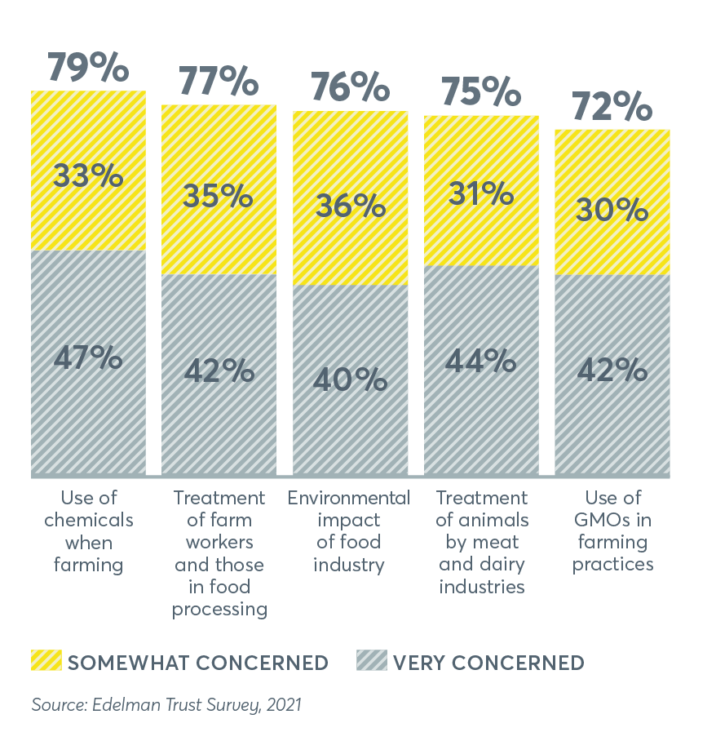


Trusted by Value Driven Consumers: The Organic Shopper
FAMILY ORIENTED
ORGANIC ALIGNS WITH CONSUMER PRIORITIES AND VALUES
Organic shoppers are 15% more likely to have children in their household.
More than 82%
of US households
stock organic food
in their kitchens.
71%
OF PARENTS USE
ORGANIC PRODUCE
65%
OF ORGANIC
PACKAGED FOOD
62%
USE ORGANIC
MILK
Notes:
References:
A majority of consumers report that organic is the label that best embodies their values. (Edelman, 2022)
Chart: The organic shopper, family oriented (Natural Marketing Institute, 2020).
Over 82% of US households stock organic food (Nielsen, 2016).
Chart: Organic aligns with consumer priorities (Edelman, 2022).

Slide 20
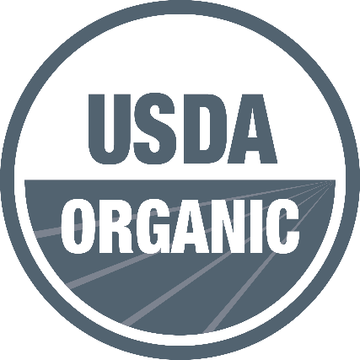
Federally Guaranteed and Traceable
Certified organic operations are inspected
at least once a year and must submit organic system plans annually to their certifier for review and approval.
Organic fraud is a crime. Cheating in organic can mean losing certification and facing significant potential financial penalties.
All field operations are inspected at least once every year.
FEDERALLY GUARANTEED
Unlike other eco-labels like “natural” or “regenerative”, the USDA Organic label is backed by third party inspection, federally enforced, and provides traceability from the farm to the consumer.
Notes:
References:
(USDA Organic Regulations 7 CFR Part 205)

Slide 21
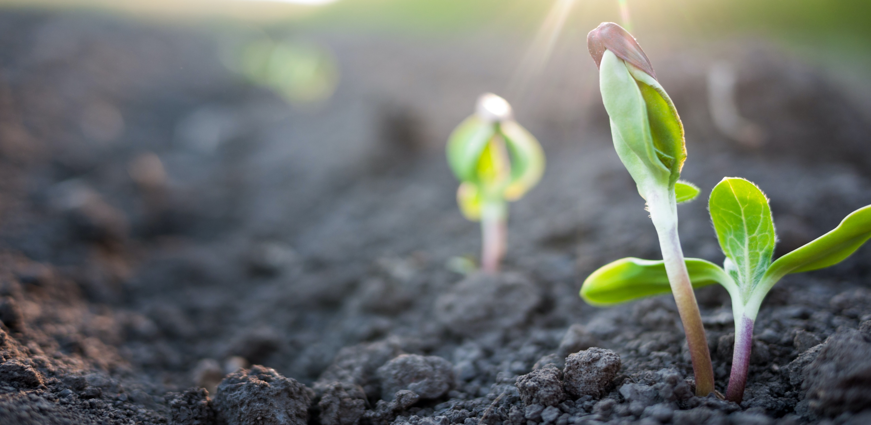

Thank You!
OTA.COM
ota.com 21

Slide 22
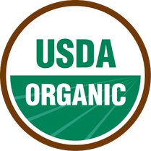









FROM FIELD TO FINISHED PRODUCT
3rd Party Certification, Traceability, Annual On-Site Inspections
COTTON
Farms are certified to internationally accepted organic standards and provided with Transaction Certificates (TCs) and unique lot numbers for traceability. TCs are required at each stage of production to
ensure authenticity.
GIN
SPINNER
FABRIC MILL
DYE HOUSE
SEWING FACTORY
FINISHED PRODUCT
GOTS certification allows brands to use the GOTS label on finished products.
Raw organic and non-organic cotton are physically separated and machines are cleaned before ginning, spinning, milling, dying, or sewing begins. Only Global Organic Textile Standard (GOTS) approved inputs are permitted in any/each stage of processing. Finished Certified Organic Products are labeled according to GOTS requirements.
Notes:
Additional slide for fiber/textile members

Slide 23




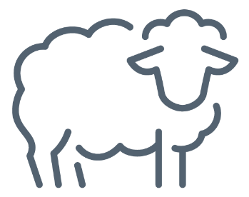


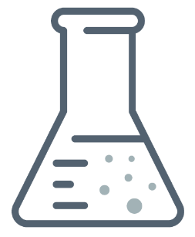


FROM FIELD TO FINISHED PRODUCT
3rd Party Certification, Traceability, Annual On-Site Inspections
SHEEP SHEARING
NOP certified organic sheep
Sorting +
Grading
Washing
+ Scouring
Carding +
Combing
Yarn Forming
+ Spinning
Dyeing +
Finishing
Knitting,
Weaving,
+ Felting
FINISHED PRODUCT
GOTS certification allows brands to use the GOTS label on finished products.
Cut +
Sew
The GLOBAL ORGANIC TEXTILE STANDARD (GOTS) defines requirements to ensure the organic status of textiles, from harvesting
of the raw materials, through environmentally and socially responsible manufacturing up to labeling in order to provide a credible assurance to the end consumer. GOTS defines high-level environmental criteria along the entire organic textiles supply chain and also requires compliance with social criteria.
• Third-party certification
• Annual facility inspection
• Social and environmental criteria
• Composition standards similar to
the National Organic Program (NOP)
• Complete traceability (flock to fashion)
• All processing aids and auxiliaries must meet
strict toxicity and biodegradability rules
• Hazardous chemicals are strictly prohibited
Notes:
Additional slide for fiber/textile members

